Slide 1


Sales Analytics – Author Analysis

Slide 2
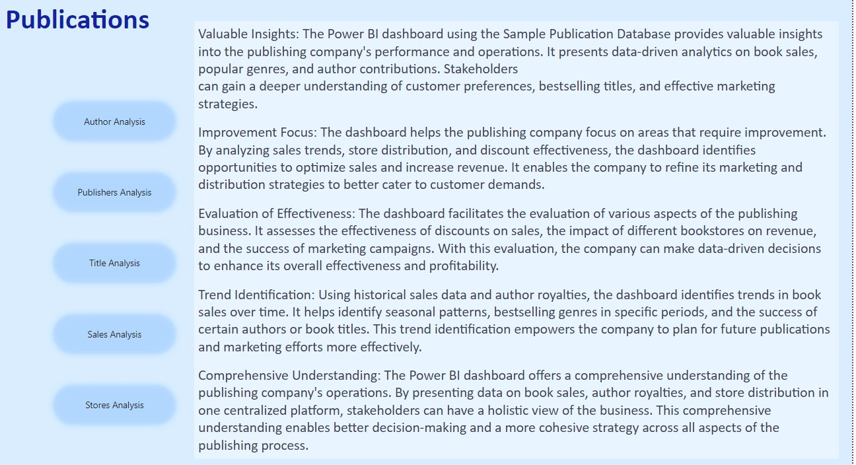

Slide 3

Objective: The objective of this project is to create a comprehensive Power BI dashboard utilizing the Sample Publication Database. The dashboard aims to provide valuable insights into the publishing company's book sales performance, author royalties, and store distribution, enabling data-driven decision-making and strategic planning.
Analysis Scope: The analysis will focus on various aspects of the publication process, including book sales, author contributions, store performance, and the impact of discounts. It will encompass historical sales data, author royalties based on royalty schedules, and distribution data from multiple bookstores.
Goal: The primary goal of this Power BI dashboard is to offer a holistic view of the publishing company's operations. It will provide actionable insights to optimize book sales, enhance author collaboration, improve store distribution strategies, and identify opportunities for growth and efficiency.

Slide 4

Insights & Recommendations: The Power BI dashboard will generate valuable insights into the top-selling book titles, bestselling genres, and sales trends over time. It will analyze the performance of different bookstores, identify bestselling authors, and calculate author royalties based on royalty schedules. Additionally, it will recommend effective discount strategies to boost book sales and customer engagement.
Report & Presentation: The final deliverable will consist of a detailed report describing the data sources, data modeling methodologies, and data cleansing processes used in creating the Power BI dashboard. The report will also include a step-by-step guide on how to interpret the insights and use the dashboard for decision-making. The presentation will showcase the key findings, visualizations, and actionable recommendations derived from the dashboard's analysis.
The Power BI dashboard, along with the report and presentation, will serve as a powerful tool for the publishing company's stakeholders. It will empower them to make informed decisions, optimize book sales strategies, foster author collaborations, and enhance the overall business performance in the competitive publishing landscape.

Slide 5
Power BI Problem
Statements

Slide 6




























Slide 7

















Slide 8










Slide 9
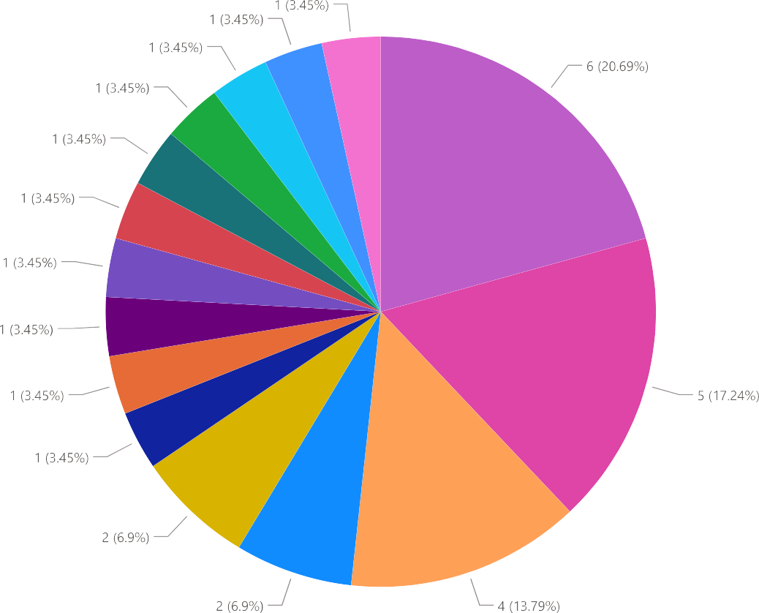







Slide 10











Slide 11










Slide 12














Slide 13











Slide 14





















Slide 15















Slide 16
































Slide 17
























Slide 18
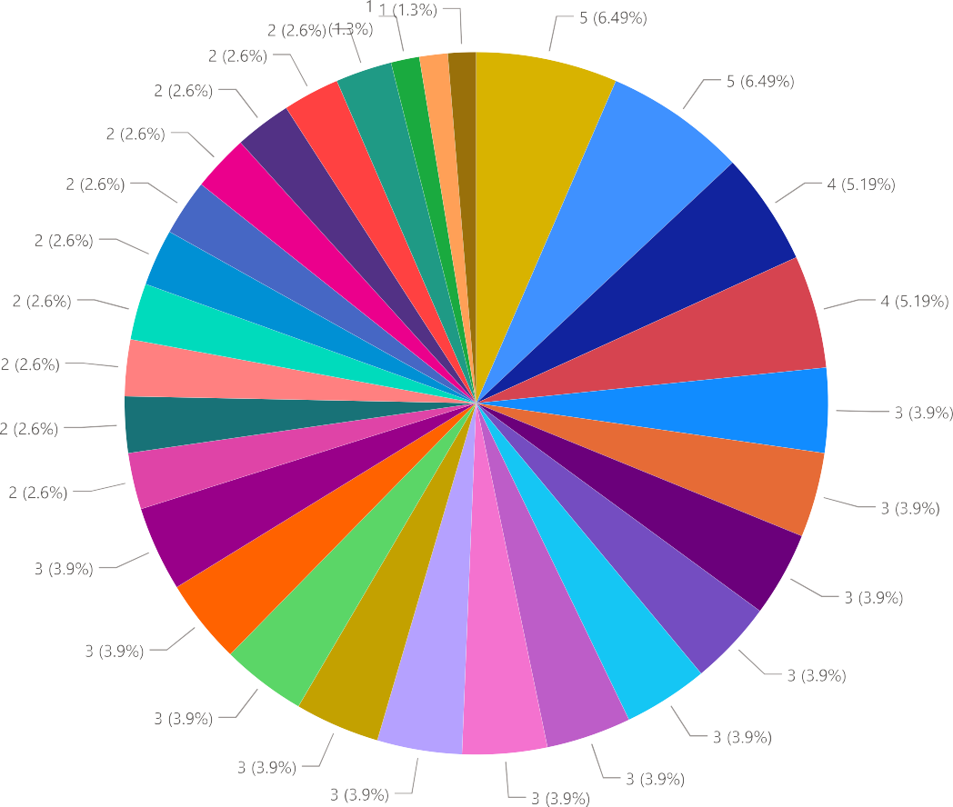













Slide 19











Slide 20

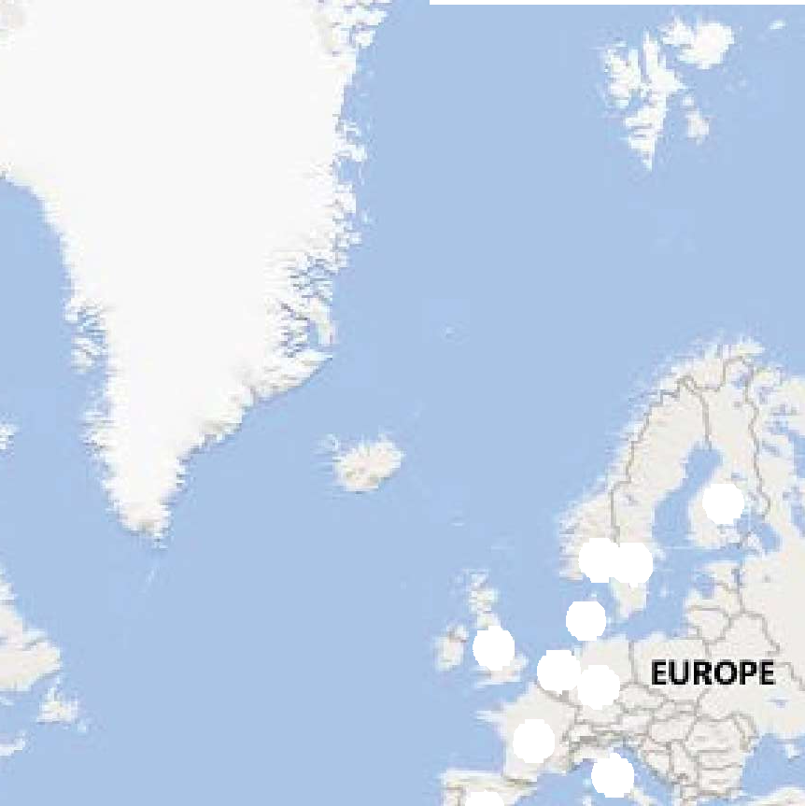











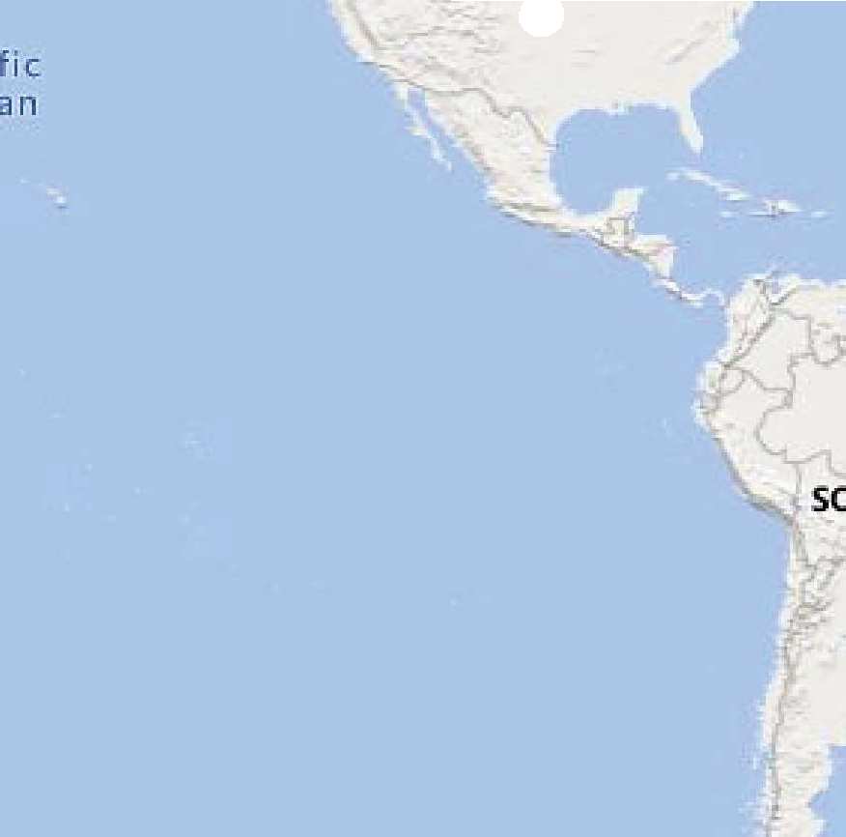
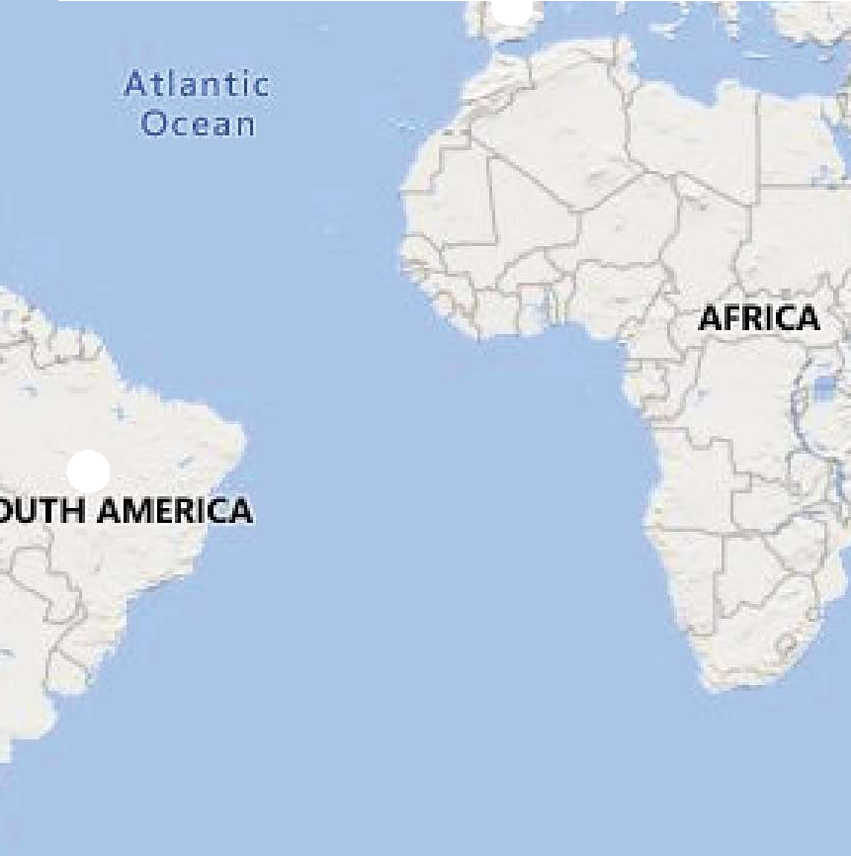














Slide 21
THANK YOU

